Slide 1

Unit – 5 SQL Views, Joins
Database Management System (DBMS-I)
DU # 2301CS302
Prof. Dixita B. Kagathara
Computer Engineering Department
dixita.kagathara@darshan.ac.in
+91 - 97277 47317 (CE Department)

Slide 2
Topics to be covered
Introduction of Views
Types of Views
Creating, Renaming, Dropping & Updating a View
Advantages and Disadvantages of Views
Table v/s View
Set Operators
Subqueries
Limitations of Subqueries
Introduction of Joins
Types of Joins
Advantages of Joins

Looping

Slide 3
Views

Slide 4

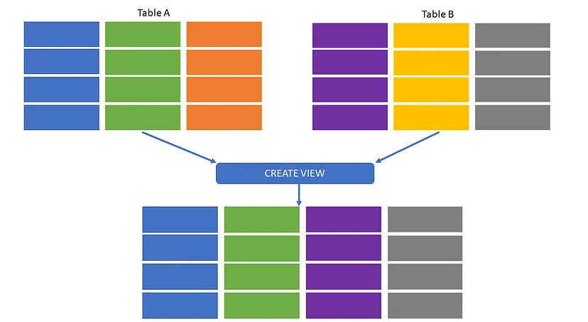
Views
Every column and row of table should not be visible to everyone.
View is a virtual or logical table that allows to view the parts of the table.
Views are virtual tables that are compiled at runtime.
View is derived from one or more than one table, those tables are known as Base Tables.
View is the result set of a stored query.
The data associated with views are not physically stored in the view, but it is stored in the base tables of the view.
Generally, we put those columns in view that we need to retrieve again and again.
Once you have created the view, you can query view like as table.
View is mapped, to a SELECT sentence.
Base Tables

Slide 5
Types of User defined View
Types of View
Simple View
Complex View
When we create a view on a single table
When we create a view on more than one table

Slide 6
Advantages of View
To restrict data access
Only Limited view of table’s data can be provided to different users.
Example – Branch manager can access their branch’s customer’s information only.
Simplification of Complex query
Complex queries can be simplified.
To provide Data independence.
To present different view of the same data.

Slide 7
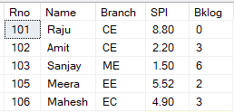
Create a simple View
Create a view Student_Details having columns Name, Branch & SPI.
Syntax to create view
CREATE
[OR ALTER]
VIEW
View_name
Student
AS
SELECT
Columns
FROM
Table_name
WHERE
Condition
;
Example-1
CREATE
VIEW
Student_Details
AS
SELECT
Name,
Branch,
SPI
FROM
Student
;

Slide 8
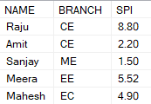
Display view
Syntax to Display view
SELECT
Columns
FROM
View_name
WHERE
Condition
;
To display Student_Details view
SELECT
*
FROM
Student_Details
;
Output (VIEW)
Student_Details

Slide 9

View Examples
Create a view STUDENT_BKLOG having all columns but students whose backlog more than 2.
SELECT * FROM STUDENT_BKLOG;
Example-2
CREATE
VIEW
STUDENT_BKLOG
AS
SELECT
*
FROM
Student
WHERE
BKLOG>2
;
Output (VIEW)

Slide 10
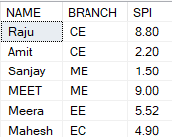
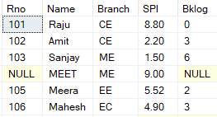
View Examples
Insert a new record to VIEW Student_Details . (Meet, ME, 9)
SELECT * FROM Student_Details;
Example-3
INSERT
INTO
Student_Details
VALUES
('MEET','ME',9)
;
Output (VIEW)
Output (Base Table)
SELECT * FROM STUDENT

Slide 11
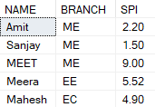
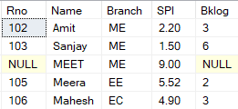
View Examples
Delete from Student_Details view whose name is ‘Raju’.
SELECT * FROM Student_Details;
Example-4
DELETE
FROM
Student_Details
WHERE
NAME=‘Raju'
;
Output (VIEW)
Output (Base Table)
SELECT * FROM STUDENT

Slide 12
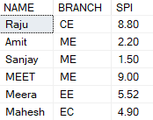
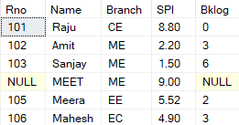
View Examples
Update the branch of Amit from CE to ME in Student_Details view.
SELECT * FROM Student_Details;
Example-5
UPDATE
Student_Details
SET
BRANCH='ME'
WHERE
NAME='AMIT'
;
Output (VIEW)
Output (Base Table)
SELECT * FROM STUDENT

Slide 13
Exercise: View
Create a view named faculty_info with name and branch column.
Create a view which contains records of ‘Computer’ branch faculty only.
Create a view name_pattern which contains name ends with ‘tel’
Create a view sal_data which contains highest salary of each branch.
Create a view vw_civil which contains records of ‘civil’ branch only.
Insert a record in vw_civil (199,’Meet Patel’, 25000,’Rajkot’,’civil’)
Update a name ‘Manish Patel ’ in view vw_civil where ID is 199
Delete record from view vw_civil where ID is 199
Faculty
ID | Name | Salary | City | Branch
258 | Ankit Patel | 50000 | Jetpur | Electrical
742 | Ketan Parmar | 75000 | Baroda | Computer
325 | Manan Doshi | 65000 | Gondal | Civil
125 | Mitesh Manek | 55000 | Rajkot | Computer
312 | Ketan Akbari | 28000 | Rajkot | Civil
Null | Bhavin Patel | 35000 | Jamnagar | Mechanical

Slide 14
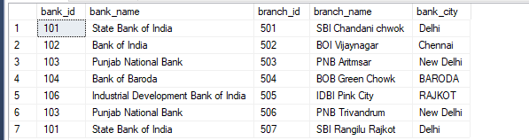
Create a Complex View
Complex View contain more than one base table.
This type of view also allow GROUP BY, JOIN clause.
Create a view on bank_detail and branch_detail table.
Now Fetch the data from bank_branch_view;
CREATE VIEW bank_branch_view
AS
SELECT bank_id, bank_name, branch_id, branch_name, bank_city
FROM bank_detail, branch_detail
WHERE bank_detail.bank_id = branch_detail.branch_bank_id;
SELECT * FROM bank_branch_view ;

Slide 15

Alter View
We can use ALTER VIEW to modify the schema or structure of a view.
We can add or remove some columns or change some conditions that are applied in a predefined view.
Syntax to alter view
ALTER
VIEW
View_name
AS
SELECT
Columns
FROM
Table_name
;
Output (VIEW)
Example
SELECT * FROM Student_Details;
ALTER
VIEW
Student_Details
AS
SELECT
Name
FROM
Student
;

Slide 16
Renaming View
There isn't a query in SQL Server that can rename a view directly.
The sp_rename is a system stored procedure in SQL that can be used to rename view.
Syntax to rename view
EXEC
sp_rename
'old_view_name'
,
'new_view_name'
;
Example
EXEC
sp_rename
‘CUSTOMERS_VIEW'
,
‘VIEW_ CUSTOMERS '
;

Slide 17
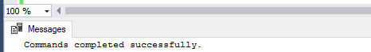
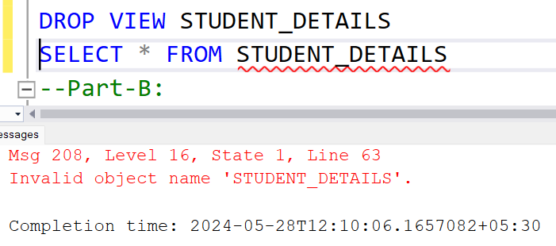
Destroy View
DROP VIEW is used to drop a specified view.
The base table will not be affected if a view is destroyed.
If a base table is dropped or column included in view are altered then view will not be valid further.
After Successfully drop the view if we try to access the view it will throw an error.
Syntax to drop view
DROP
VIEW
View_name
;
Example
Output
DROP
VIEW
Student_Details
;
ERROR !!!

Slide 18
Disadvantages of View
When table is dropped view is also becomes inactive.

Slide 19
Update View (Point To Keep in Mind)
If the user insert/update/delete any record/s in view, it will also affect its base table.
If a user tries to insert any record in view then at that time, the base table’s PRIMARY KEY column and NOT NULL column constraints must be fulfil.
We only modify data using view if it affects only one base table.
Common Restriction on Updatable View
It can not include:
Aggregate functions
DISTINCT, GROUP BY or HAVING clause
Sub queries
UNION, INTERSECTION or MINUS clause

Slide 20
Table v/s View
Difference
Parameters | Table | View
Definition | A table stores the data. | A view only extracts data from the table.
Dependency | A table is an independent database entity. | A view is dependent on the table.
Database space | It is stored in physical storage as it occupies real space on systems. | It is not stored physically. It only requires some space in memory whenever we run its query.

Slide 21
SET Operators

Slide 22
SET Operators
The four set operators union, union all, intersect and except allow us to serially combine two or more select statements.
Operator | Description
Union | Combine two or more result sets into a single set, without duplicates.
Union All | Combine two or more result sets into a single set, including all duplicates.
Intersect | Takes the data from both result sets which are in common.
Except | Takes the data from first result set, but not the second (i.e. no matching to each other)

Slide 23
Union
The UNION operator is used to combine the result-set of two or more SELECT statements.
The UNION operator removes duplicate rows and returns result in ascending order.
Table1
A
B
C
Table2
C
X
Y
A
B
X
Y
C
Output

Slide 24

Union
Syntax
E.g.
SELECT
*
Columns
FROM
Table1
Emp2016
UNION
SELECT
*
Columns
Table2
FROM
Emp2018
;
Union
Name | Salary
Anil | 1000
Anil | 6000
Mahesh | 5000
Rohit | 8000
Sunil | 3000
Emp2016
Name | Salary
Anil | 1000
Sunil | 3000
Mahesh | 5000
Emp2018
Name | Salary
Anil | 6000
Sunil | 3000
Rohit | 8000

Slide 25
Union All
The UNION ALL operator is used to combine the result-set of two or more SELECT statements.
The UNION ALL operator does not removes duplicate rows.
Table1
A
B
C
Table2
C
X
Y
A
B
X
Y
C
C
Output

Slide 26
Union All
Syntax
E.g.
SELECT
*
Columns
FROM
Table1
Emp2016
UNION ALL
SELECT
*
Columns
Table2
FROM
Emp2018
;
UnionAll
Name | Salary
Anil | 1000
Sunil | 3000
Mahesh | 5000
Anil | 6000
Sunil | 3000
Rohit | 8000
Emp2016
Name | Salary
Anil | 1000
Sunil | 3000
Mahesh | 5000
Emp2018
Name | Salary
Anil | 6000
Sunil | 3000
Rohit | 8000

Slide 27
Intersect
The INTERSECT operator is used to return common records between two SELECT statements.
If a record exists in one query and not in the other, it will be omitted from the INTERSECT results.
The Intersect operator removes duplicate rows and returns result in ascending order.
Table1
A
B
C
Table2
C
X
Y
A
B
X
Y
C
Output

Slide 28
Intersect
Syntax
E.g.
SELECT
*
Columns
FROM
Table1
Emp2016
INTERSECT
*
SELECT
Columns
Table2
FROM
Emp2018
;
Emp2016
Name | Salary
Anil | 1000
Sunil | 3000
Mahesh | 5000
Emp2018
Name | Salary
Anil | 6000
Sunil | 3000
Rohit | 8000
Intersect
Name | Salary
Sunil | 3000

Slide 29
Except
EXCEPT operator is used to combine two SELECT statements and returns rows from the first SELECT statement that are not returned by the second SELECT statement.
This means EXCEPT returns only rows, which are not available in the second SELECT statement.
The Except operator removes duplicate rows and returns result in ascending order.
Left
Query
Right
Query
Combine
Output

Slide 30
Except
Syntax
E.g.
SELECT
*
Columns
FROM
Table1
Emp2016
Except
*
FROM
SELECT
Columns
Table2
Emp2018
;
Emp2016
Name | Salary
Anil | 1000
Sunil | 3000
Mahesh | 5000
Emp2018
Name | Salary
Anil | 6000
Sunil | 3000
Rohit | 8000
Except
Name | Salary
Anil | 1000
Mahesh | 5000

Slide 31
Rules on Set Operations
The result sets of all queries must have the same number of columns.
The columns in both the tables must have compatible data types.
In order to sort the result, an ORDER BY clause should be part of the last statement.

Slide 32
Subqueries

Slide 33
Sub Query
Sub query is query inside other query.
Subquery returns result from an inner query to an outer clause.
It is a SELECT statement that nests inside the WHERE, HAVING or SELECT of other SELECT.
Query -2
Outer Query
INPUT
Query -1
Inner Query
OUTPUT
OUTPUT

Slide 34
Types of Sub Query
Single Row Sub Query (Scalar Value)
Multiple Row Sub Query
Correlated Sub Query

Slide 35
Single Row Sub Query
It is also known as scalar sub query.
Returns 0 or 1 row.
Can be used with <,>,<=,>= etc. operators.
Example: Display name of staff who has maximum salary.
First we have to find maximum salary from Faculty Table.
Then find out his/her name whose salary is maximum.
(
SELECT FNAME FROM Faculty WHERE SAL =
SELECT MAX(SAL) FROM Faculty
);
Faculty
Output
FID | HID | FNAME | SUB | DID | SAL
11 | 12 | PATEL | CP | 7 | 10000
12 | - | PANDYA | SM | 6 | 30000
13 | 12 | DOSHI | TOM | 19 | 15000
14 | 12 | MAKWANA | BE | 9 | 18000
15 | 12 | MEHTA | ACP | 7 | 12000
16 | 12 | SHAH | - | - | 50000
FNAME
SHAH

Slide 36
Multiple Row Sub Query
Returns one or more rows.
Can be used with IN, NOT IN, ANY, ALL etc. operators
Example: Display Roll no, Department id and SPI of those students who are from RAJKOT.
First we will find out the roll no. of those students who are from RAJKOT
Here we will get more than one records/rows who are from RAJKOT. (That’s why it is known as Multiple Row Subquery)
Next we will compare all those roll no. and find their department id and SPI from Academic Table.
(
);
SELECT RNO,DID,SPI FROM ACADEMIC WHERE RNO IN
SELECT RNO FROM STUDENT WHERE CITY='RAJKOT'
Academic
Student
To compare more than one value we can not use =
Output
RNO | DID | SPI | CPI | BACKLOG
101 | 19 | 6.8 | 6.1 | 1
102 | 7 | 7.2 | 6.5 | 0
103 | 6 | 8.5 | 7.2 | 0
104 | 7 | 6.1 | 5.2 | 3
105 | 9 | 8.1 | 7.5 | 3
RNO | SNAME | ADDRESS | CITY | MOBILE
101 | MITESH | RING ROAD | RAJKOT | 7845128956
102 | KAUSHAL | SADHU VASVANI ROAD | RAJKOT | 8989547412
103 | ANKUR | GONDAL ROAD | RAJKOT | 8866552241
104 | KISHAN | SANADA ROAD | MORBI | 9663322110
105 | MUKESH | RAJKOT ROAD | JAMNAGAR | 9425814789
RNO | DID | SPI
101 | 19 | 6.8
102 | 7 | 7.2
103 | 6 | 8.5

Slide 37
Correlated Sub Query
It is also known as synchronized query.
It is a subquery that uses a values from outer query.
Each subquery is executed for every row of the outer query.
Here inner query is executes more than one time where as in other subqueries inner query executes only one time.

Slide 38
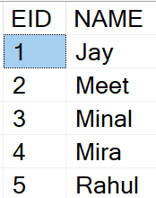
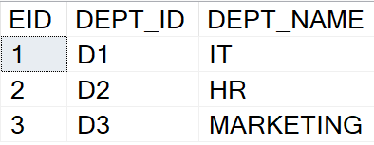

Correlated Sub Query
TABLES
EMP
DEPT
✓
×
×
CORRELATE SUBQUERY
OUTPUT
SELECT * FROM EMP
WHERE EXISTS
(SELECT EID FROM DEPT
WHERE
EMP.EID=DEPT.EID)

Slide 39

Correlated Sub Query
TABLES
EMP
DEPT
×
✓
×
CORRELATE SUBQUERY
OUTPUT
SELECT * FROM EMP
WHERE EXISTS
(SELECT EID FROM DEPT
WHERE
EMP.EID=DEPT.EID)

Slide 40

Correlated Sub Query
TABLES
EMP
DEPT
×
×
✓
CORRELATE SUBQUERY
OUTPUT
SELECT * FROM EMP
WHERE EXISTS
(SELECT EID FROM DEPT
WHERE
EMP.EID=DEPT.EID)

Slide 41
Correlated Sub Query
TABLES
EMP
DEPT
×
×
×
CORRELATE SUBQUERY
OUTPUT
SELECT * FROM EMP
WHERE EXISTS
(SELECT EID FROM DEPT
WHERE
EMP.EID=DEPT.EID)

Slide 42
Correlated Sub Query
TABLES
EMP
DEPT
×
×
×
CORRELATE SUBQUERY
OUTPUT
SELECT * FROM EMP
WHERE EXISTS
(SELECT EID FROM DEPT
WHERE
EMP.EID=DEPT.EID)

Slide 43
Limitation of Sub Query
Complexity: Subqueries can increase the complexity of SQL statements, potentially leading to performance degradation.
Execution Cost: Subqueries, especially correlated subqueries, can be computationally expensive as they might be executed multiple times.
Nested Structure: Deeply nested subqueries can make SQL statements harder to read and understand, making them more difficult to maintain.
Debugging: Debugging SQL queries with multiple subqueries can be challenging.
Scalability Issues: As the data volume grows, the performance of subqueries can degrade significantly, affecting the overall scalability of the application.

Slide 44
Joins

Slide 45
Joins
An SQL JOIN clause is used to combine rows from two or more tables, based on a common field between them.
Types of Join
Inner Join
Outer Join
Cross Join
Self Join
Left Outer Join
Right Outer Join
Full Outer Join

Slide 46
Inner Join
Inner Join returns records that have matching values in both tables.
Table1
Table2
Combine
Output
Syntax
SELECT
columns
FROM
Table1
INNER JOIN
Table2
ON
Table1.column=Table2.column
;

Slide 47

Example: Inner Join
Example
SELECT
Student.RNO,
Student.Name,
Student.Branch,
Result.SPI
FROM
Student
INNER JOIN
Result
ON
Student.RNO= Result.RNO
;
Student
RNO | Name | Branch
101 | Raju | CE
102 | Amit | CE
103 | Sanjay | ME
104 | Neha | EC
105 | Meera | EE
106 | Mahesh | ME
Result
RNO | SPI
101 | 8.8
102 | 9.2
104 | 8.2
105 | 7
107 | 8.9
Output
RNO | Name | Branch | SPI
101 | Raju | CE | 8.8
102 | Amit | CE | 9.2
104 | Neha | EC | 8.2
105 | Meera | EE | 7

Slide 48

Example: Inner Join
Inner Join without using Join Keyword
Student
RNO | Name | Branch
101 | Raju | CE
102 | Amit | CE
103 | Sanjay | ME
104 | Neha | EC
105 | Meera | EE
106 | Mahesh | ME
Result
RNO | SPI
101 | 8.8
102 | 9.2
104 | 8.2
105 | 7
107 | 8.9
Syntax
SELECT
Columns
FROM
Table1
,
Table2
WHERE
Table1.column=Table2.column
;
Example
Output
RNO | Name | Branch | SPI
101 | Raju | CE | 8.8
102 | Amit | CE | 9.2
104 | Neha | EC | 8.2
105 | Meera | EE | 7
SELECT
S.RNO,
S.Name,
S.Branch,
R.SPI
FROM
Student S
,
Result R
WHERE
Student.RNO= Result.RNO
;

Slide 49
Left outer Join
Left outer join return all records from the left table, and the matched records from the right table.
Table1
Table2
Combine
Output
Syntax
SELECT
columns
FROM
Table1
LEFT OUTER JOIN
Table2
ON
Table1.column=Table2.column
;

Slide 50
Example: Left outer Join
Example
SELECT
Student.RNO,
Student.Name,
Student.Branch,
Result.SPI
FROM
Student
LEFT OUTER JOIN
Result
ON
Student.RNO= Result.RNO
;
Student
RNO | Name | Branch
101 | Raju | CE
102 | Amit | CE
103 | Sanjay | ME
104 | Neha | EC
105 | Meera | EE
106 | Mahesh | ME
Result
RNO | SPI
101 | 8.8
102 | 9.2
104 | 8.2
105 | 7
107 | 8.9
Output
RNO | Name | Branch | SPI
101 | Raju | CE | 8.8
102 | Amit | CE | 9.2
103 | Sanjay | ME | NULL
104 | Neha | EC | 8.2
105 | Meera | EE | 7
106 | Mahesh | ME | NULL

Slide 51
Right outer Join
Right outer join return all records from the right table, and the matched records from the left table.
Table1
Table2
Combine
Output
Syntax
SELECT
columns
FROM
Table1
RIGHT OUTER JOIN
Table2
ON
Table1.column=Table2.column
;

Slide 52
Example: Right outer Join
Example
SELECT
Student.RNO,
Student.Name,
Student.Branch,
Result.SPI
FROM
Student
RIGHT OUTER JOIN
Result
ON
Student.RNO= Result.RNO
;
Student
RNO | Name | Branch
101 | Raju | CE
102 | Amit | CE
103 | Sanjay | ME
104 | Neha | EC
105 | Meera | EE
106 | Mahesh | ME
Result
RNO | SPI
101 | 8.8
102 | 9.2
104 | 8.2
105 | 7
107 | 8.9
Output
RNO | Name | Branch | SPI
101 | Raju | CE | 8.8
102 | Amit | CE | 9.2
104 | Neha | EC | 8.2
105 | Meera | EE | 7
NULL | NULL | NULL | 8.9

Slide 53
Full outer Join
Full outer join return all records when there is a match in either left or right table.
Table1
Table2
Combine
Output
Syntax
SELECT
columns
FROM
Table1
FULL OUTER JOIN
Table2
ON
Table1.column=Table2.column
;

Slide 54
Example: Full outer Join
Example
SELECT
Student.RNO,
Student.Name,
Student.Branch,
Result.SPI
FROM
Student
FULL OUTER JOIN
Result
ON
Student.RNO= Result.RNO
;
Student
RNO | Name | Branch
101 | Raju | CE
102 | Amit | CE
103 | Sanjay | ME
104 | Neha | EC
105 | Meera | EE
106 | Mahesh | ME
Result
RNO | SPI
101 | 8.8
102 | 9.2
104 | 8.2
105 | 7
107 | 8.9
Output
RNO | Name | Branch | SPI
101 | Raju | CE | 8.8
102 | Amit | CE | 9.2
103 | Sanjay | ME | NULL
104 | Neha | EC | 8.2
105 | Meera | EE | 7
106 | Mahesh | ME | NULL
NULL | NULL | NULL | 8.9

Slide 55
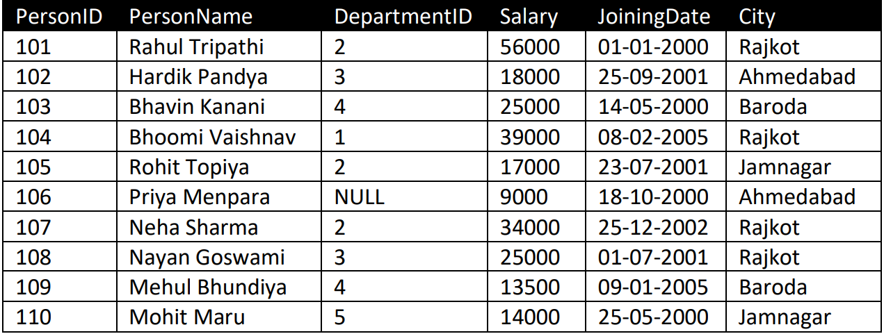
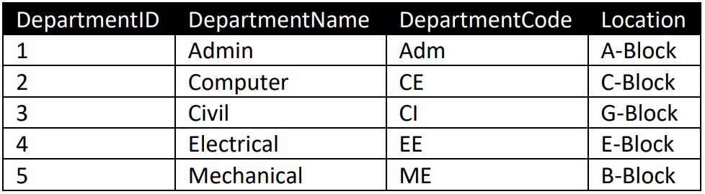
Exercise: Joins
Display person name and their dept name.
Display person’s department location.
Display Person’s name, Dept name, salary and city.
Display person name, salary and dept code.
Display personID, name, joining date and deptname.
Display person name and dept who belongs to Rajkot
Display person name who is sitting in ‘C-Block’
Display person name, dept whose salary is more then 20000
Display person name, dept code who does not belongs to Baroda
Display person name who works in computer department.
person’s name of the person who joined the Civil department after 1-Aug-2001
Display person’s name whose name starts from ‘B’ in Electrical department.
Display person’s name and dept who lives in Ahmedabad and salary less than 20000
Display person’s name whose personID is less then 105 and deptcode is ‘CI’
Display person’s name who belongs to Computer or Civil Dept
PERSON
DEPT

Slide 56
Exercise: Joins
PERSON
Display average salary of computer department.
Display Total Salary of Department located in 'A-Block’
Display department wise highest salary.
Display total salaries in each department.
Count employee per department.
Display average salary for employee in ‘Rajkot’
Count of Employees per dept who joined after the year 2000
Average Salary of Employees in 'Computer’ dept grouped by City
Sum of Salaries for Employees who Joined before 2001, in each Department.
Count of Employees per Department with Salaries Above 25000.
Total Salary for each Department, with Departments having more than 2 Employees.
Find all departments whose total salary is exceeding 100000
List all departments who have no person.
Count of Employees in Each City per Department.
Produce Output Like: <PersonName> lives in <City> and works in <DepartmentName> Department. (In single column)
DEPT

Slide 57
Cross Join
Cross join produces Cartesian product of the tables that are involved in the join.
The size of a Cartesian product is the number of the rows in the first table multiplied by the number of rows in the second table like this.
Table1
1
2
3
Table2
A
B
C
Syntax
SELECT
*
FROM
table1
Cross Join
,
table2
;

Slide 58
Example: Cross Join
Output
RNO | Name | Branch | SPI
101 | Raju | CE | 8.8
102 | Amit | CE | 8.8
103 | Sanjay | ME | 8.8
104 | Neha | EC | 8.8
105 | Meera | EE | 8.8
106 | Mahesh | ME | 8.8
101 | Raju | CE | 9.2
102 | Amit | CE | 9.2
103 | Sanjay | ME | 9.2
104 | Neha | EC | 9.2
105 | Meera | EE | 9.2
106 | Mahesh | ME | 9.2
101 | Raju | CE | 8.2
102 | Amit | CE | 8.2
103 | Sanjay | ME | 8.2
104 | Neha | EC | 8.2
105 | Meera | EE | 8.2
106 | Mahesh | ME | 8.2
101 | Raju | CE | 7
102 | Amit | CE | 7
103 | Sanjay | ME | 7
104 | Neha | EC | 7
105 | Meera | EE | 7
106 | Mahesh | ME | 7
101 | Raju | CE | 8.9
102 | Amit | CE | 8.9
103 | Sanjay | ME | 8.9
104 | Neha | EC | 8.9
105 | Meera | EE | 8.9
106 | Mahesh | ME | 8.9
Student
RNO | Name | Branch
101 | Raju | CE
102 | Amit | CE
103 | Sanjay | ME
104 | Neha | EC
105 | Meera | EE
106 | Mahesh | ME
Result
RNO | SPI
101 | 8.8
102 | 9.2
104 | 8.2
105 | 7
107 | 8.9
Example
SELECT
*
FROM
Student
Cross Join
,
Result
;

Slide 59
Self Join
A Self Join is a regular join, but the table is joined with itself.
Self join is used to retrieve the records having similarity between records in the same table.
Here, we need to use aliases for the same table to set a self join between single table.
Self join would be of any type like inner self join, left self join, right self join etc.

Slide 60
Self Join
Syntax
Employee
EmpNo | Name | MngrNo
E00001 | Tarun | E00002
E00002 | Rohan | E00005
E00003 | Priya | E00005
E00004 | Milan | NULL
E00005 | Jay | NULL
E00006 | Anjana | E00003
SELECT
a.Column_Name,
b.Column_Name
Output: Employee
Employee | Manager
Tarun | Rohan
FROM
Table1 a
Inner Join
Table1 b
Rohan | Jay
ON
a.Column=b.Column
;
Priya | Jay
Anjana | Priya
Example
Employee e
EmpNo | Name | MngrNo
E00001 | Tarun | E00002
E00002 | Rohan | E00005
E00003 | Priya | E00005
E00004 | Milan | NULL
E00005 | Jay | NULL
E00006 | Anjana | E00003
Employee m
EmpNo | Name | MngrNo
E00001 | Tarun | E00002
E00002 | Rohan | E00005
E00003 | Priya | E00005
E00004 | Milan | NULL
E00005 | Jay | NULL
E00006 | Anjana | E00003
SELECT
e.Name as Employee,
m.Name as Manager
FROM
Employee e
Inner Join
Employee m
ON
e.MngrNo=m.EmpNo
;

Slide 61
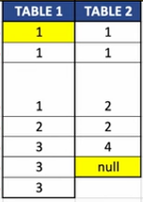
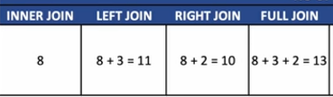
Exercise
No of records in inner join:??????
No of records in left outer join?????
No of records in right outer join?????
No of records in full outer join?????

Slide 62
Join Examples
Table1
Table2
Left Outer Join
Right Outer Join
Full Outer Join
Select * From
T1 LEFT JOIN T2
ON T1.Id1=T2.Id2;
Select * From
T1 RIGHT JOIN T2
ON T1.Id1=T2.Id2;
Select * From
T1 FULL JOIN T2
ON T1.Id1=T2.Id2;

Slide 63
Join Examples(Cont..)
Table1
Table2
Unmatched Rows From Left Table
Unmatched Rows From Right Table
Unmatched Rows From Left and Right Table
Select * From
T1 LEFT JOIN T2
ON T1.Id1=T2.Id2
Where T2.Id2 IS NULL
Select * From
T1 RIGHT JOIN T2
ON T1.Id1=T2.Id2
Where T1.Id1 IS NULL
Select * From
T1 FULL JOIN T2
ON T1.Id1=T2.Id2
Where T1.Id1 IS NULL Or T2.Id2 IS NULL

Slide 64
Join Examples(Cont..)
Unmatched Rows From the Left Table
SELECT
Employee.EID,
Employee.Name,
Employee.Dept,
EmpSalary.Amount
FROM
Employee
Full Outer Join
EmpSalary
ON
Employee.EID= EmpSalary.EID
WHERE
EmpSalary.EID
IS
NULL
;
Employee
EID | Name | Dept
101 | Raju | Admin
102 | Amit | Admin
103 | Sanjay | HR
104 | Neha | IT
105 | Meera | Sales
106 | Mahesh | HR
EmpSalary
EID | Amount
101 | 1000
102 | 5000
104 | 3000
105 | 8000
107 | 2500
Output
EID | Name | Dept | Amount
103 | Sanjay | HR | NULL
106 | Mahesh | HR | NULL

Slide 65
Join Examples(Cont..)
Unmatched Rows From the Right Table
SELECT
Employee.EID,
Employee.Name,
Employee.Dept,
EmpSalary.Amount
FROM
Employee
Full Outer Join
EmpSalary
ON
Employee.EID= EmpSalary.EID
WHERE
Employee.EID
IS
NULL
;
Employee
EID | Name | Dept
101 | Raju | Admin
102 | Amit | Admin
103 | Sanjay | HR
104 | Neha | IT
105 | Meera | Sales
106 | Mahesh | HR
EmpSalary
EID | Amount
101 | 1000
102 | 5000
104 | 3000
105 | 8000
107 | 2500
Output
EID | Name | Dept | Amount
NULL | NULL | NULL | 2500

Slide 66
Join Examples(Cont..)
Unmatched Rows From the Left and Right Table
SELECT
Employee.EID,
Employee.Name,
Employee.Dept,
EmpSalary.Amount
FROM
Employee
Full Outer Join
EmpSalary
ON
Employee.EID= EmpSalary.EID
WHERE
Employee.EID
IS
NULL
OR
EmpSalary.EID
IS
NULL
;
Employee
EID | Name | Dept
101 | Raju | Admin
102 | Amit | Admin
103 | Sanjay | HR
104 | Neha | IT
105 | Meera | Sales
106 | Mahesh | HR
EmpSalary
EID | Amount
101 | 1000
102 | 5000
104 | 3000
105 | 8000
107 | 2500
Output
EID | Name | Dept | Amount
103 | Sanjay | HR | NULL
106 | Mahesh | HR | NULL
NULL | NULL | NULL | 2500

Slide 67
Advantages of Joins
It executes faster.
The retrieval time of the query using joins almost always will be faster than that of a subquery.

Slide 68
Join v/s Sub query
Difference
Parameters | Join | Subquery
Definition | A Join is a concept used to fetch rows from two or more tables based on a related column or set of columns. | A Subquery (Nested Query) is a query that is embedded within another SQL query. This is also a technique to fetch data from multiple tables.
Types | Inner, Outer, Cross, Self | Single Row, Multi-Row, Correlated
When to use | JOINs are used when the relationships between the tables are known and fixed. | Subqueries are often used when the result of the query is not known or dynamic...
Advantage | Joins help with a clear and concise way to retrieve data without the need for additional filtering or processing. | Subqueries help us to perform complex filtering and calculations based on the results of the inner query.
Limitation | While Joins work well for combining data from different tables, they may not be suitable for certain complex data manipulations. | Subqueries may make the SQL code more complex and harder to read.

Slide 69
Thank You

